Slide 1
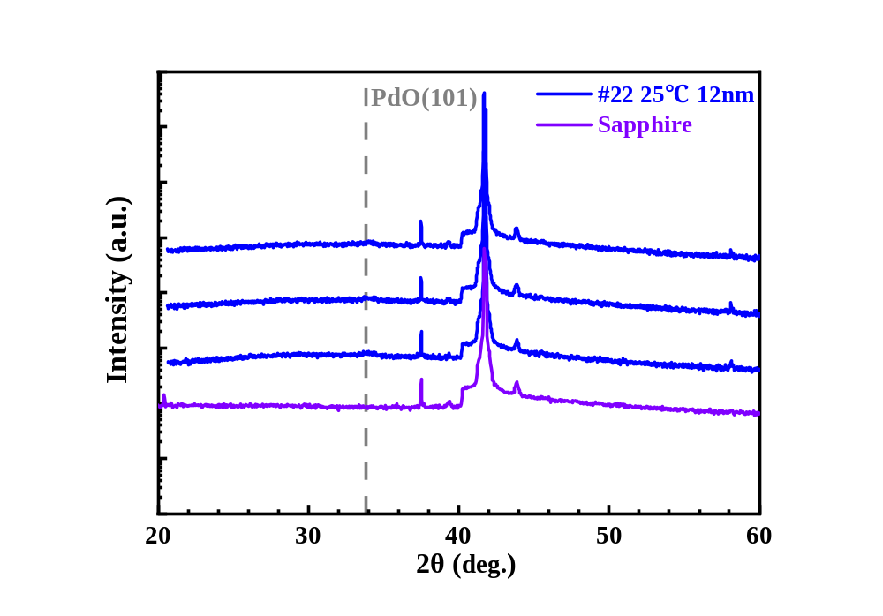
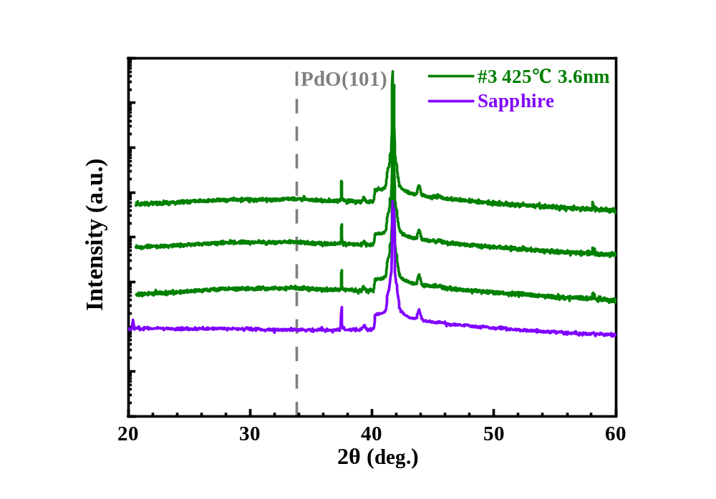
SOBOL XRD
XRD tested on 42 samples on sapphire with measurable Hall mobility.
Deposition temperature and thickness is critical for crystallinity.
Sample deposited at 25℃ remain amorphous when thickness ≤ 12nm.
Sample deposited at 425℃ remain amorphous when thickness ≤ 4nm.

Slide 2
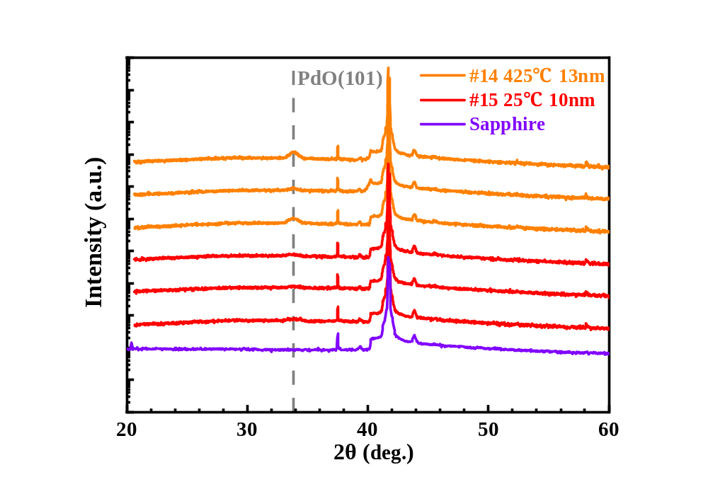
SOBOL XRD
 | Hall mobility (cm^2/V-s) | Carrier concentration (#/cm^3)
#14 | 9.91 | 1.74E+19
 | <Contact Fail> | <Contact Fail>
 | 6.28 | 1.53E+19
#15 | 8.68 | 3.16E+19
 | 8.91 | 3.17E+19
 | 8.94 | 3.26E+19
Run | Dep Power (W) | O2 Flow (sccm) | Dep Press (mTorr) | Dep Temp (°C) | Ox Temp (°C) | Ox Press (atm) | Ox Time (min) | Vac Ann Temp (°C) | Vac Ann Time (min) | Dep Thickness (nm)
14 | 36 | 13.4 | 6.3 | 425 | 694.7 | 0.02 | 1.1 | 217.4 | 29.1 | 7.8
15 | 27 | 6 | 4.5 | 25 | 649.3 | 0.02 | 62.7 | 362.2 | 46.5 | 6.2
#15 shows low crystallinity, average Hall mobility of 8.84cm²/V-s, and average carrier concentration of 3.20·10¹⁹/cm³.
Crystallinity can be further reduced by adjusting thickness.

Slide 3
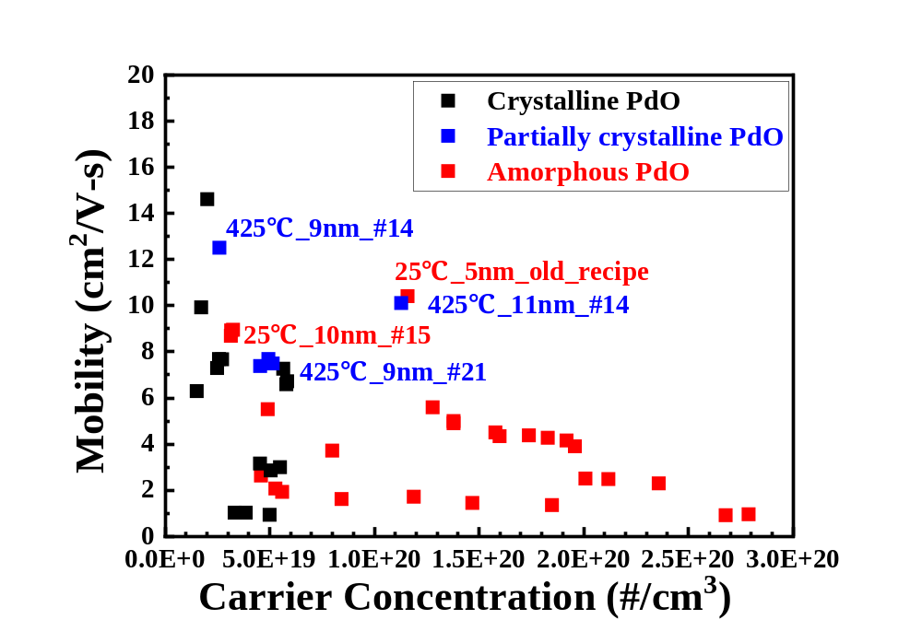
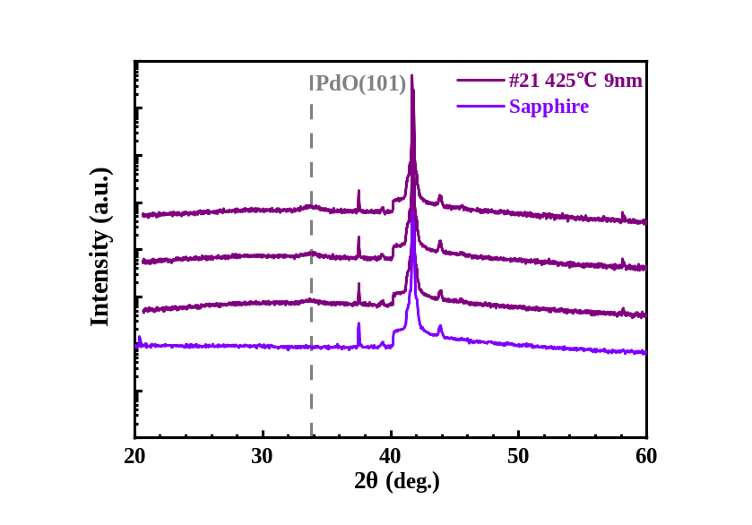
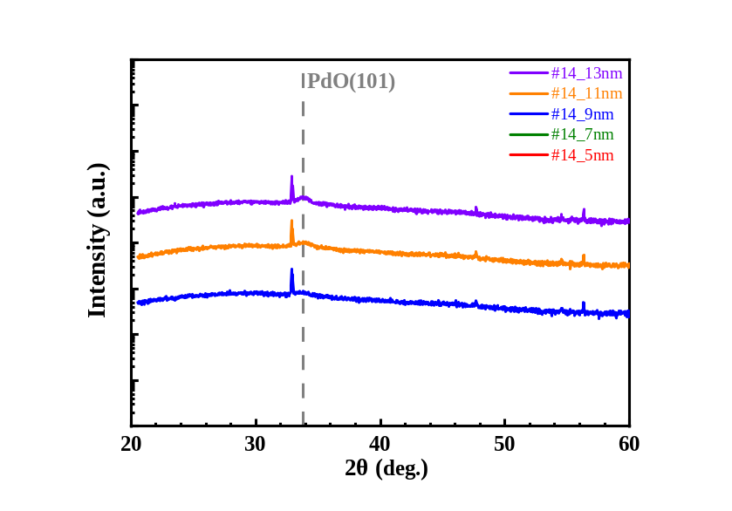
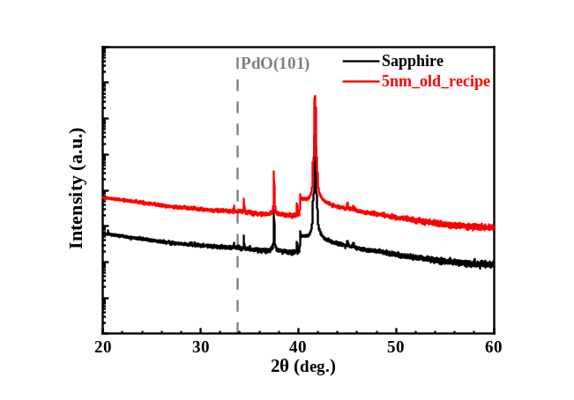
SOBOL XRD
#15 shows low crystallinity, average Hall mobility of 8.84cm²/V-s, and average carrier concentration of 3.20·10¹⁹/cm³.

